Slide 1


Experiential Marketing
DataLucent Ambassador Programs

Slide 2
Ambassador Program Outline
University
Local
Grassroots
Influencer
Twitch
YouTube
Instagram

Slide 3

University Ambassadors
Recruit a few individuals on each campus as DL ambassadors
Limit the number of people each ambassador can recruit
Use serialized cards
Unique codes that can’t be guessed
Users enter code to show which ambassador recruited them
Shared Incentive
The user gets the standard $5 reward, with the ambassador also receiving $5 for each valid file received using their code
Cost per user: $10

Slide 4
Example: Local University
Option 1: Ambassador/student shared incentive
10 Students hired to promote DL to friends
Each student with a valid file receives the $5 standard reward, with the ambassador receiving $5
Cost per user: $10
Student ambassador receives: $5 per user
Option 2: Fundraiser event
Find an ambassador with a cause that needs funding (theater, charity, club, etc.)
Provide unique code for the event with a limited time window that it may be used within
Each valid file provides an $8 donation directly to the cause in their name
Cost per user: $8
Student group receives: $8 per user
We can validate their files live for their event

Slide 5
Influencer Ambassadors
Recruit influencers on video and social platforms to promote DL to their audience.
Twitch, YouTube, and Instagram, are all good first options.
Provide shared incentive opportunities where users and influencers mutually benefit.
Audiences love supporting their influencers and many will jump at the chance to do so.
Create code that influencer can use to send to their audience.
Limit the number of times this code can be used to prevent overheating or gaming.

Slide 6

Example: Twitch Ambassadors
Option 1: Streamer/User Shared Incentives
The streamer receives a limited use code that they share on stream with their audience.
For each valid file submitted using this code, the streamer receives $5 payment and the user receives $5 on Amazon gift card which may be used on Twitch.
Cost per user: $10
Option 2: Streamer/User Mixed Incentives
Streamer promotes Twitch landing page using code they share with audience
4 in 5 users gets their normal $5 reward for the file
Streamers gain: $5 guaranteed, with another $5 potentially gained
1 in 5 users win a $20 Twitch.tv gift card instead of $5 reward
Cost per user: $8
Streamers potentially gain up to: $8 per user, with $4 guaranteed to be on Twitch

Slide 7
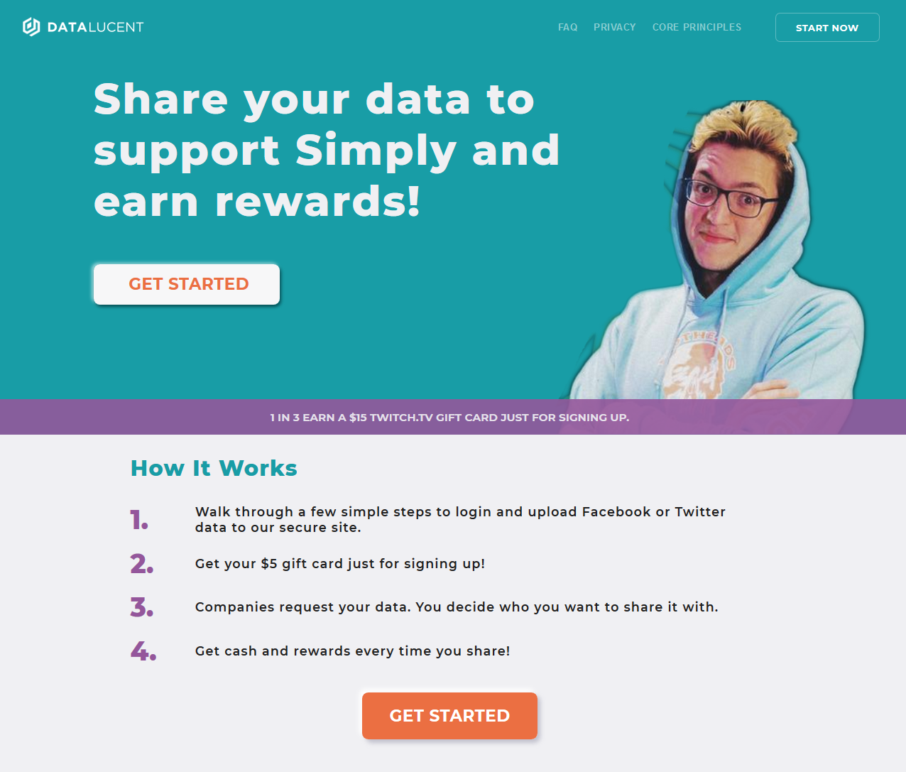
Sample Influencer Landing Page

Slide 8
Recruitment
Universities:
Club fairs
Student centers
Job offices
Influencers:
Agencies
Recruitment platforms (such as Powerspike.tv)
Direct solicitation

